Slide 1
Mole: Motion Leaks through Smartwatch Sensors
He wang
Ted Tsung-Te Lai
Romit Roy Choudhury
University of Illinois at
Urbana-Champaign
Champaign, IL, USA
Presenter: Hao Kong

Slide 2
outline
Motivation
Preliminary
System Overview
System Design
Evaluation

Slide 3
Can smartwatch know what you are typing?
Prevent user’s input data from being stolen or eavesdropped is a research hotspot in the area of security and privacy.
With the popularity of IoT, smartwatches show a growing acceptance among users.
Motion sensors are integrated into smartwatches, which could record the motion state of hands.

Slide 4
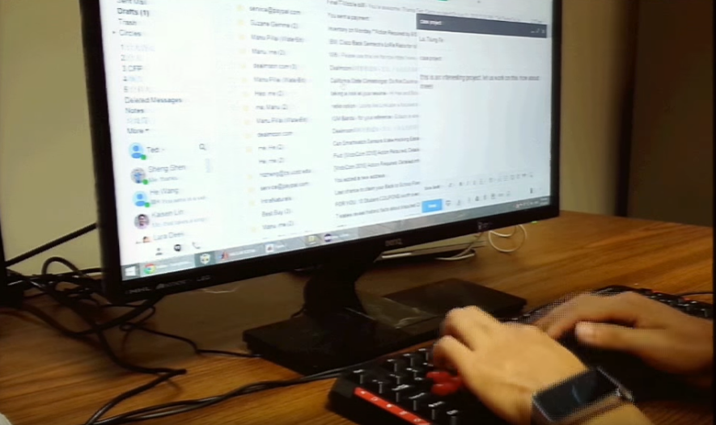
Can smartwatch know what you are typing?
When a user is typing with a smartwatch, the hand moves according to each letter.
Is it possible to infer input words through smartwatch motion sensors?
If so, how much?

Slide 5
outline
Motivation
Preliminary
System Overview
System Design
Evaluation

Slide 6
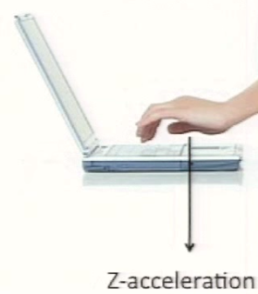
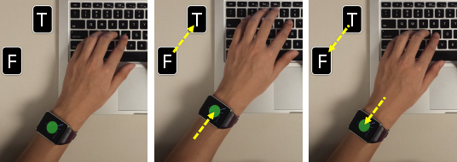
A correlation between watch movement and keystrokes.

Slide 7
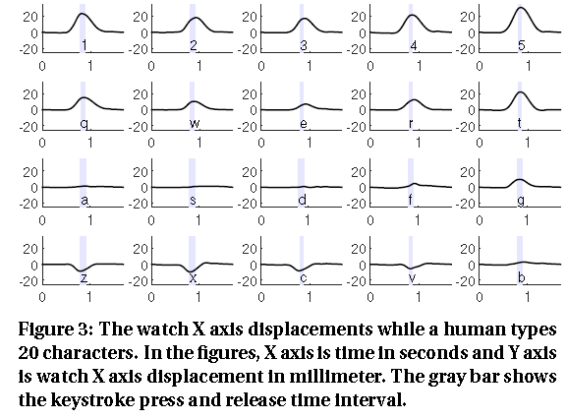
Detection of each individual keystrokes.

Slide 8
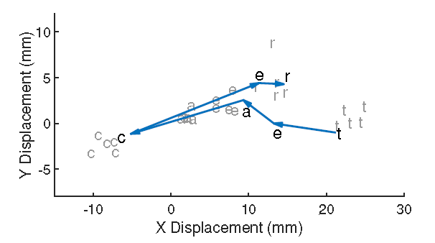
2d displacements of individual and continuous typing
Individual
Continuous

Slide 9
Challenges
Correctly detect a typing motion from the noisy data obtained by motion sensors.
The watch location cannot represent each keystroke.
Information form the right hand is missing.

Slide 10
outline
Motivation
Preliminary
System Overview
System Design
Evaluation

Slide 11
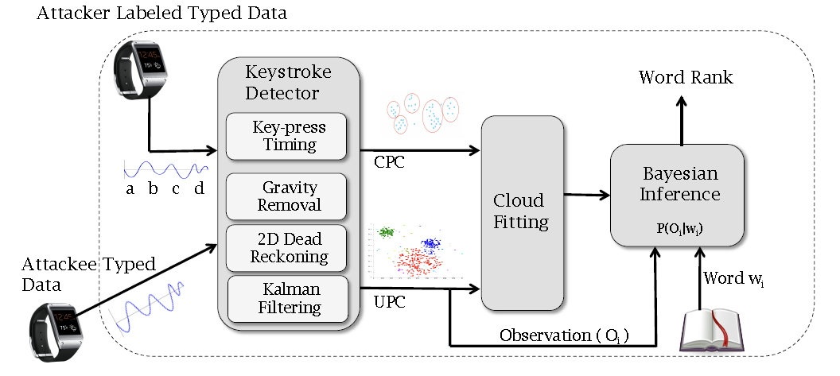
Architecture

Slide 12
outline
Motivation
Preliminary
System Overview
System Design
Evaluation

Slide 13
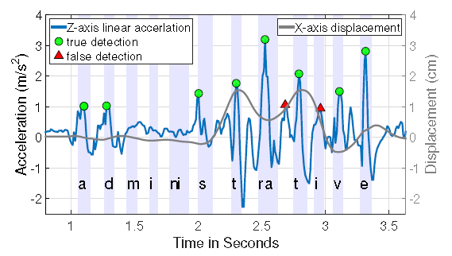
Keystroke Detection

Slide 14
Keystroke Detection
Approaches:
Using a low threshold to mark all potential keystrokes.
Extract features from the Z-peaks, the 3-axis displacement, velocity, acceleration, etc.
Train bagged decision trees to detect keystrokes.

Slide 15
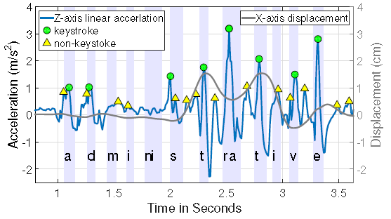
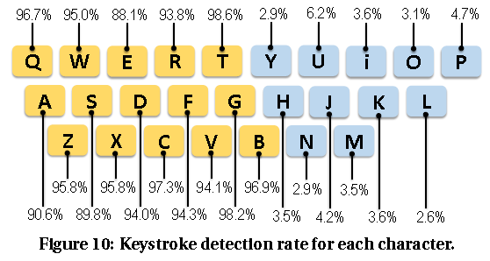
Keystroke Detection

Slide 16
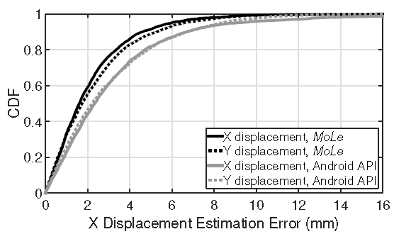
Key-Press Location Estimation
Define an absolute coordinate system.
Estimate and remove gravity.
Estimate the coordinate value and calculate projected acceleration.
Calibrate by mean removal.
Kalman smoothing.

Slide 17
Architecture

Slide 18
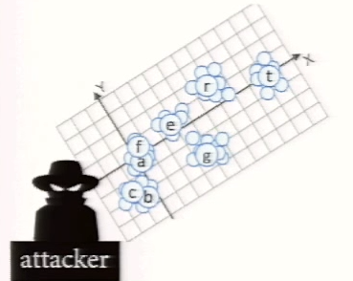
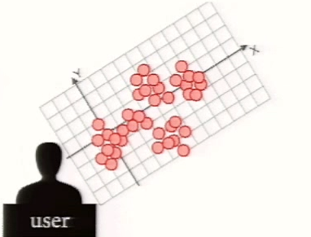
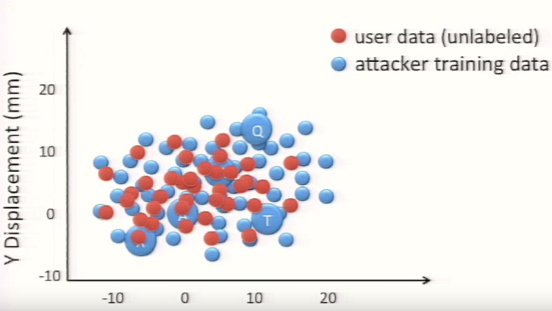
Point Cloud Fitting
The key intuition is that relative motions between keys should be similar between users.

Slide 19
Point Cloud Fitting
Finding each convex hull
Calculate the centroids and perform rotate and scale

Slide 20
Architecture

Slide 21
Bayesian Inference
s

Slide 22
Bayesian Inference
$$P\left(W | O\right)=\frac{P\left(O | W\right)P(W)}{P(O)}$$
Since $P(O)$ is the same for all possible words, and we assume $P\left(W\right)$ is equal among words.
$$P(W|O)∝P(O|W)$$
When we obtain such an observation O, which word can maximize the probability?

Slide 23
Bayesian Inference
Using the number of keystrokes
When 2 keystrokes are detected
likely
unlikely
good, then
hence, forever

Slide 24
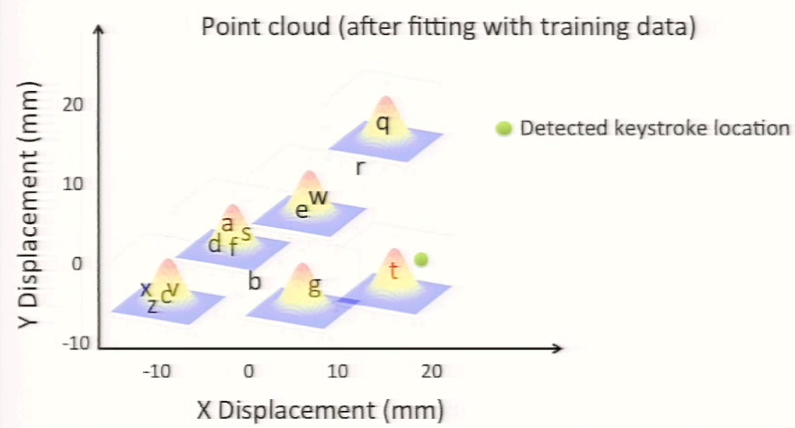
Bayesian Inference
2. Adding watch displacement
After the fitting of UPC and CPC, we can match detected keystrokes into a specific character.

Slide 25
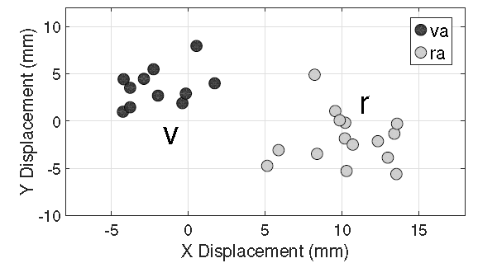
Bayesian Inference
2. Adding watch displacement
Note that typing a word consists of sequential movements and the current displacement is indeed influenced by the location of the previous characters.

Slide 26
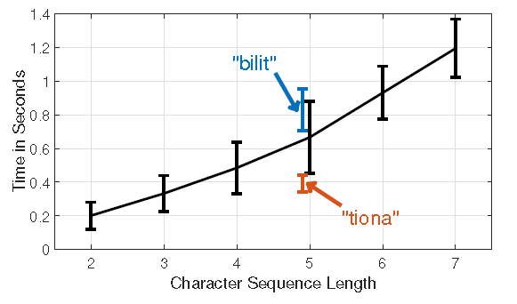
Bayesian Inference
3. Considering keystroke interval
This paper obtains the time interval distribution of every possible character-sequence that is preceded and followed by two left-hand characters, and use this distribution in the Bayesian model.

Slide 27
Bayesian Inference

Slide 28
outline
Motivation
Preliminary
System Overview
System Design
Evaluation

Slide 29
Experiment Setup
Device: Galaxy Gear Live smart watch.
8 Participants:
300 words for each participant.
Words are selected from 5000 most frequently used words.
2 labeled point clouds (training data)
2 persons collect offline data with top-500 longest words.

Slide 30
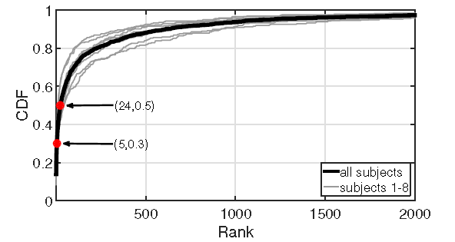
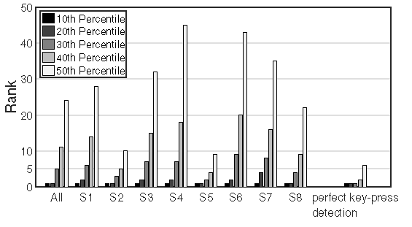
Performance
How well can Melo guess each words?

Slide 31
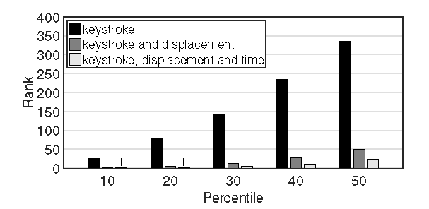
Performance
How are the three observation improve system performance?

Slide 32
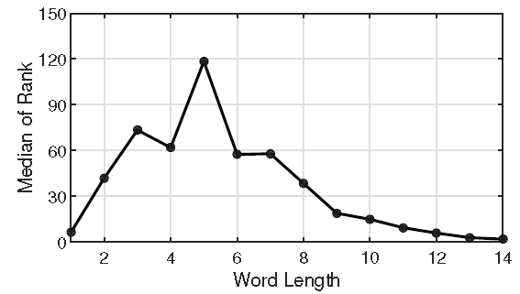
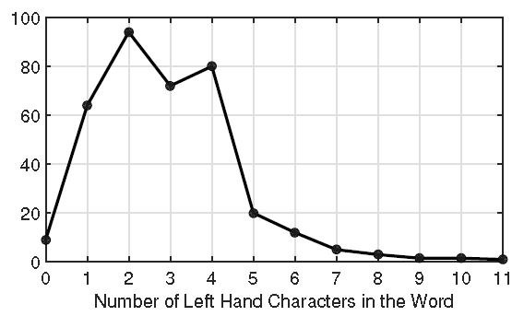
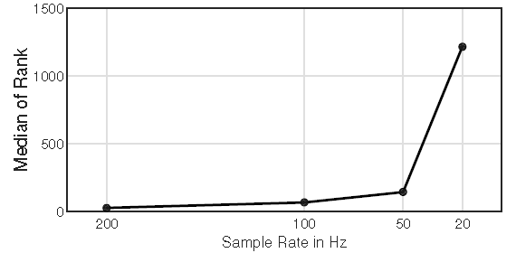
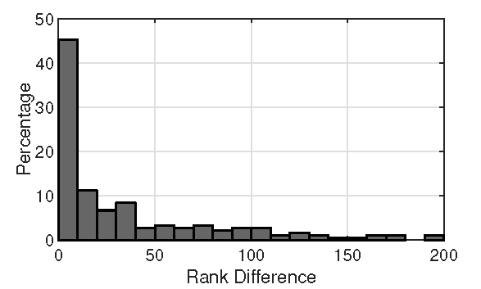
Performance
Impacts of different factors
Word length
Number of left hand characters
Sampling rate
Keyboard variant

Slide 33
Limitations
Single word only
unable to detect space
English words only
digital and non-English words are not applicable
Required standard typing method

Slide 34
Conclusion
Mole: Motion leaks through smartwatch sensor
Identify leaks when using watch motion sensors to infer input words
Type a word W with length>6, it can shortlist 10 words (rank 10) on average that includes W.

